Slide 1

💓 Heart Disease Prediction Using Machine Learning

Slide 2

Team members name :
Sagar Jain - 36215602723
Somil Gupta - 20315602723
Vaibhav Kathait - 16015602723
Supervisor : Ms. Naina Devi

Slide 3



Introduction: Why Early Detection Matters
Heart disease remains a leading cause of mortality globally. Early detection is crucial for timely intervention and improved patient outcomes.
Impact of Heart Disease
Importance of Early Detection
ML in Healthcare
A major health burden, affecting millions worldwide and contributing to significant healthcare costs.
Enables proactive treatment, lifestyle changes, and better prognosis for individuals at risk.
Machine Learning offers powerful tools to analyze complex medical data and identify hidden patterns for prediction.

Slide 4
Problem Statement: The Need for Efficient Prediction
Current diagnostic methods can be time-consuming and costly. There is a pressing need for:
Quick, Accurate Detection
Cost-Effective Solutions
Accessibility
Rapid identification of potential heart disease cases to enable immediate medical attention.
Reducing the financial burden associated with extensive diagnostic procedures.
Making predictive tools available to a wider range of healthcare providers and patients.

Slide 5
Project Objectives
Our primary goals for this project include:
Create a User-Friendly Web App
Develop a Predictive Model
Deploy the model within an intuitive Streamlit application for practical use.
Utilize machine learning algorithms to accurately predict heart disease presence.
Evaluate Model Performance
Provide Data Insights
Assess the accuracy and reliability of the developed ML models.
Incorporate visualizations to highlight key factors influencing heart disease prediction.

Slide 6





Technology Stack
The core technologies empowering our heart disease prediction system:
Python
Streamlit
Scikit-learn
Matplotlib & Seaborn
The primary programming language for data processing and model development.
Used for building and deploying the interactive web application.
A powerful library for machine learning algorithms and model training.
Libraries for generating comprehensive data visualizations.
Joblib
Used for efficient serialization of trained machine learning models.

Slide 7


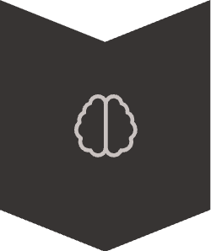


System Architecture
A simplified flow of our heart disease prediction system:
Dataset
Kaggle Heart Disease dataset with raw patient information.
Preprocessing
Data cleaning, scaling, and feature engineering to prepare for analysis.
Model Training
Application of ML algorithms to learn from the preprocessed data.
Deployment
Hosting the trained model and web application for accessibility.
Prediction
Users input data to receive real-time heart disease probability.

Slide 8
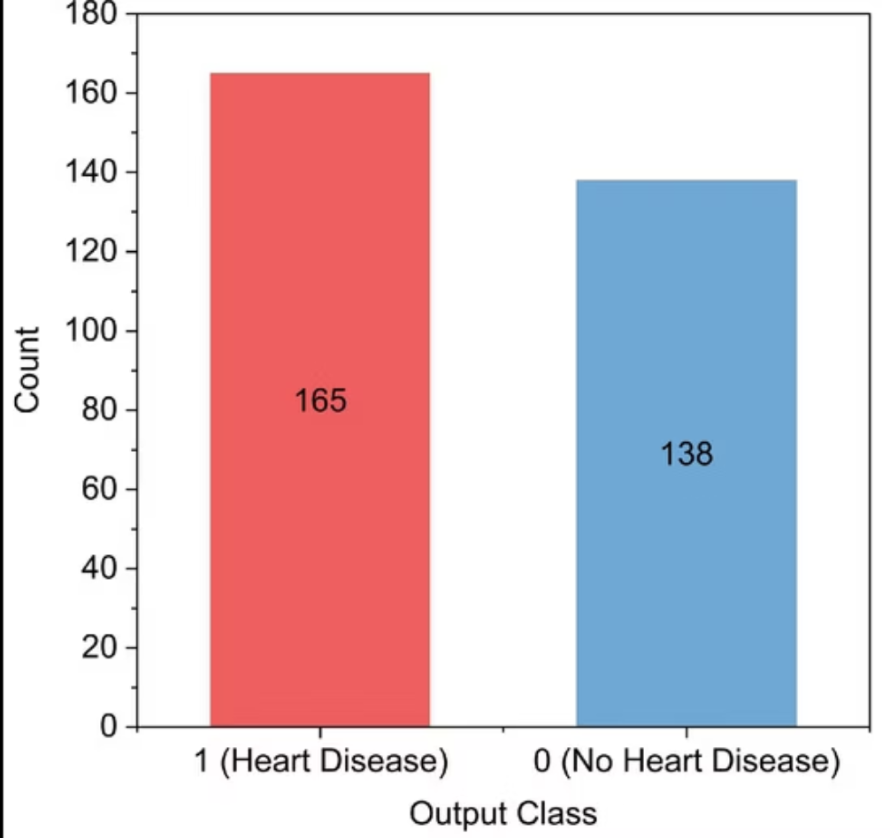
Key Modules & Features
Our system comprises the following essential components:
Model Training Pipeline
Prediction Web Application
Data Visualizations
Automated process for training, evaluating, and selecting the best-performing ML models.
An interactive Streamlit interface for users to input patient data and get predictions.
Graphical representations of data distribution, feature importance, and model performance.
if st.button('Predict Heart Disease'): prediction = model.predict(input_data) # ... display result
from sklearn.linear_model import LogisticRegressionmodel = LogisticRegression()model.fit(X_train, y_train)

Slide 9
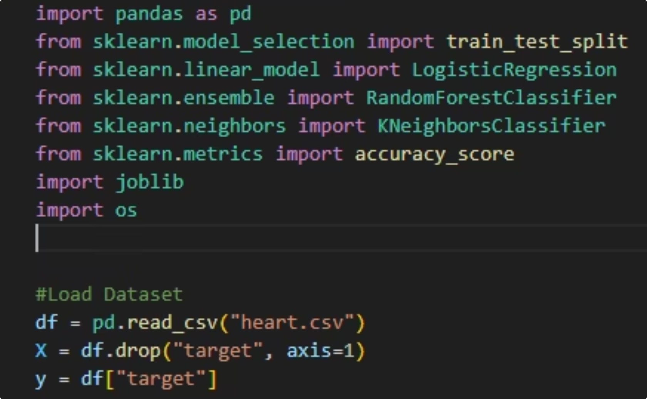
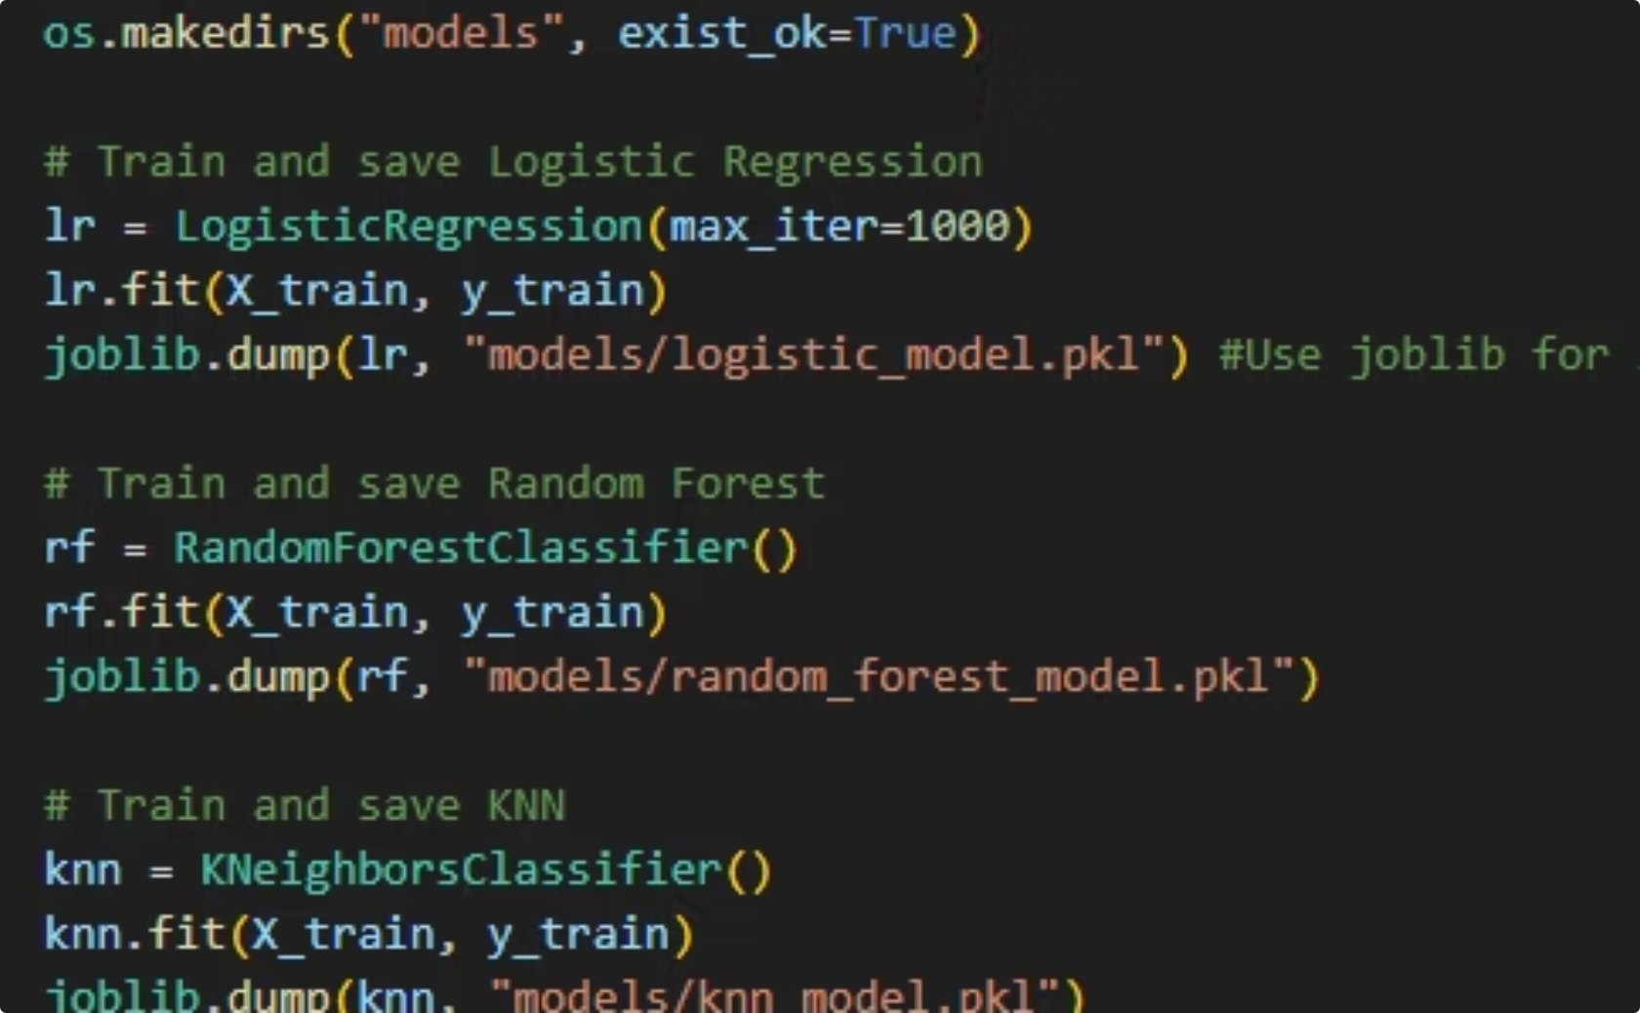
code :
importing libraries
Training data

Slide 10
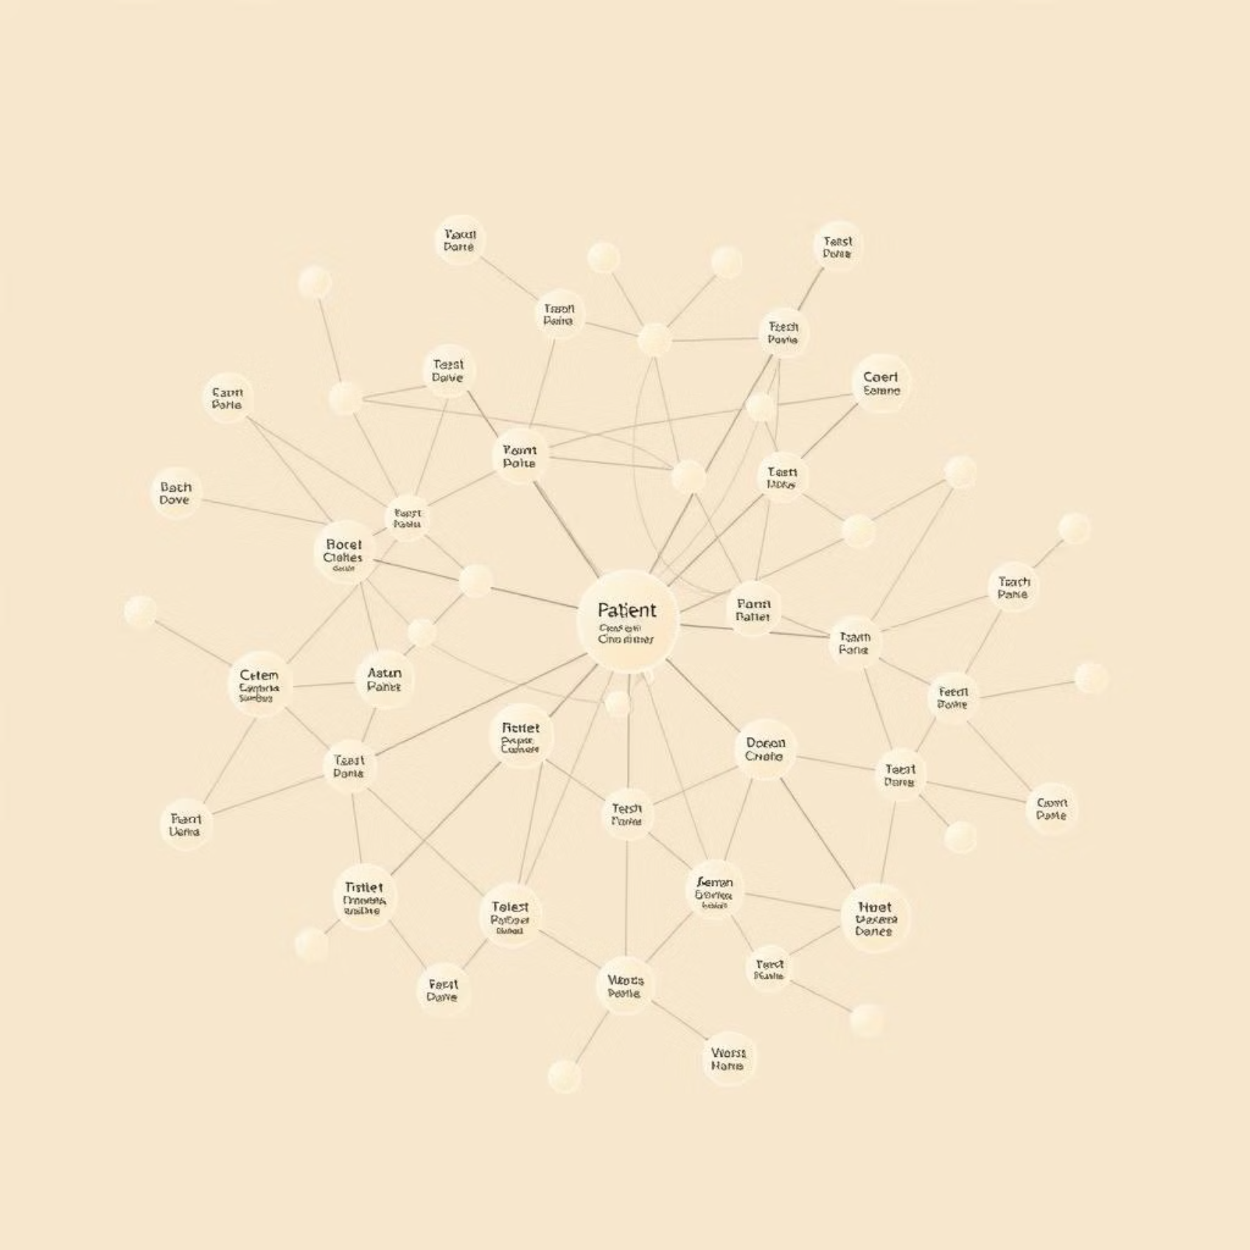
Dataset Used: Kaggle Heart Disease
For this project, we leveraged the widely recognized kaggle Heart Disease Dataset:
The Kaggle Heart Disease dataset is a public repository of medical records often used for machine learning research in cardiology. It provides a solid foundation for training and testing predictive models.
Source: Kaggle
Records: 303 individual patient records
Attributes: 13 clinical features (e.g., age, sex, chest pain type, cholesterol, blood pressure)
Target Variable: Binary (0 = no heart disease, 1 = heart disease)

Slide 11
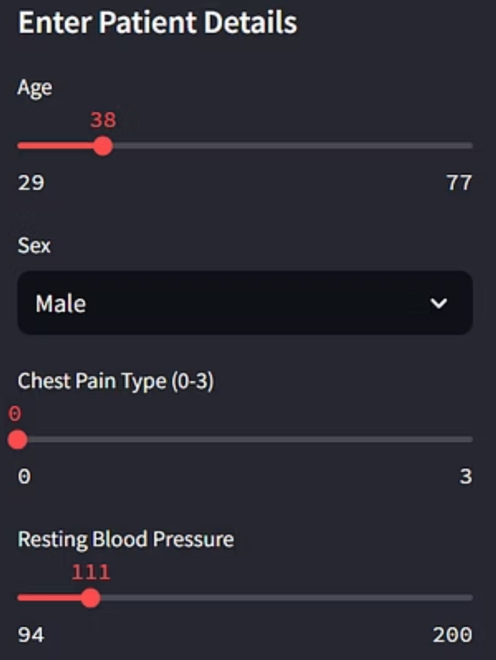
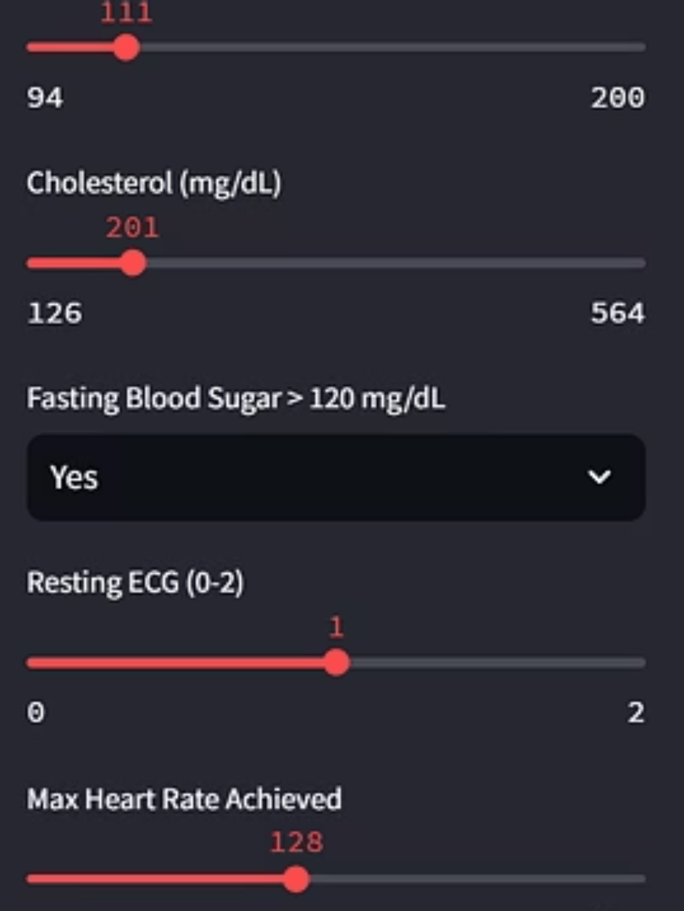
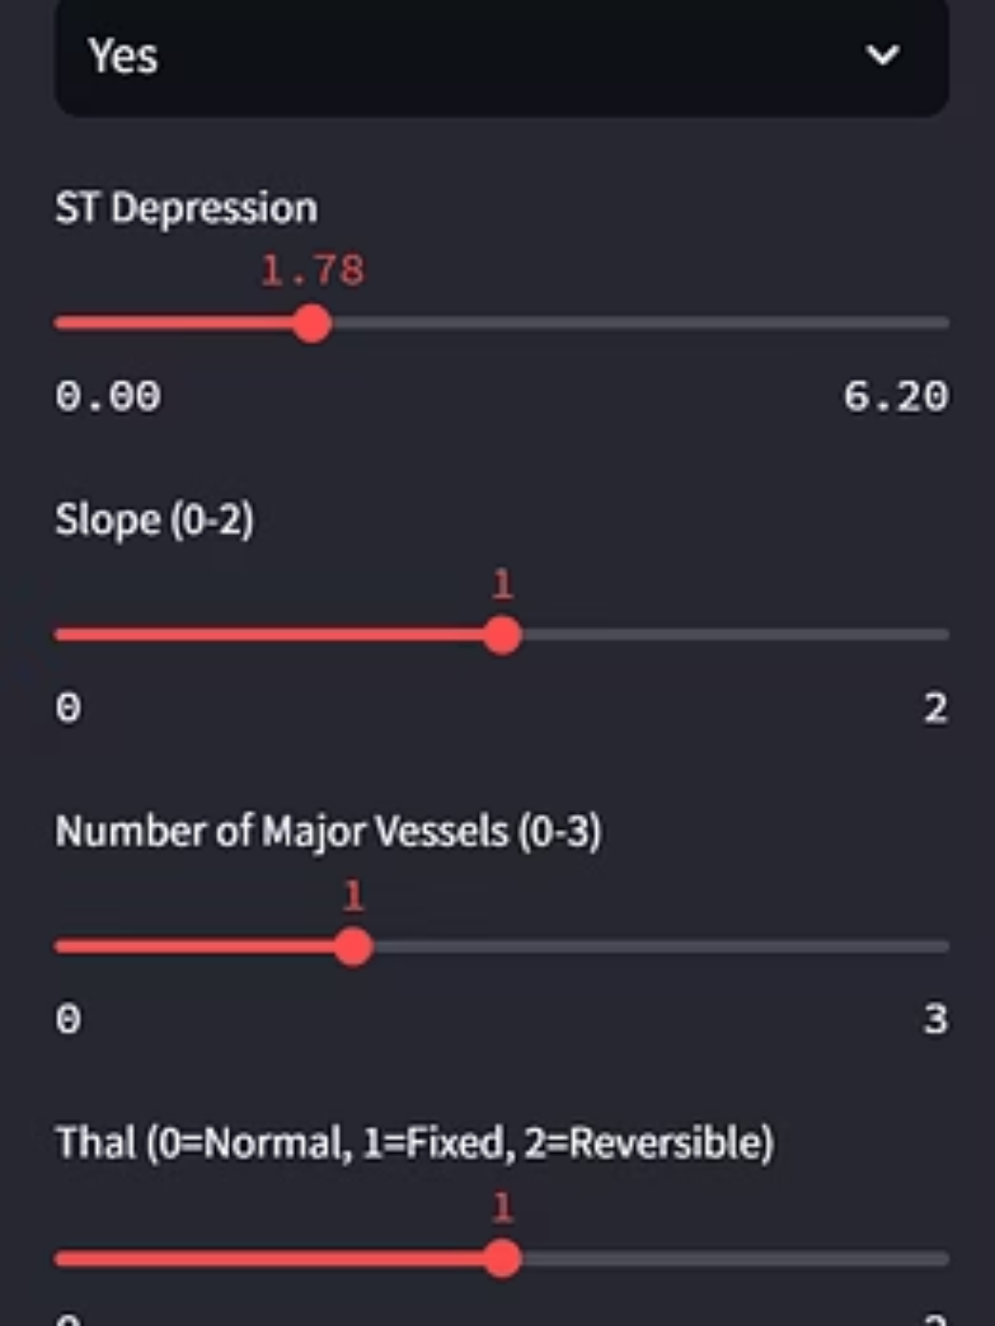
Implementation: Streamlit App Interface
Our intuitive web application makes predictions accessible:

Slide 12
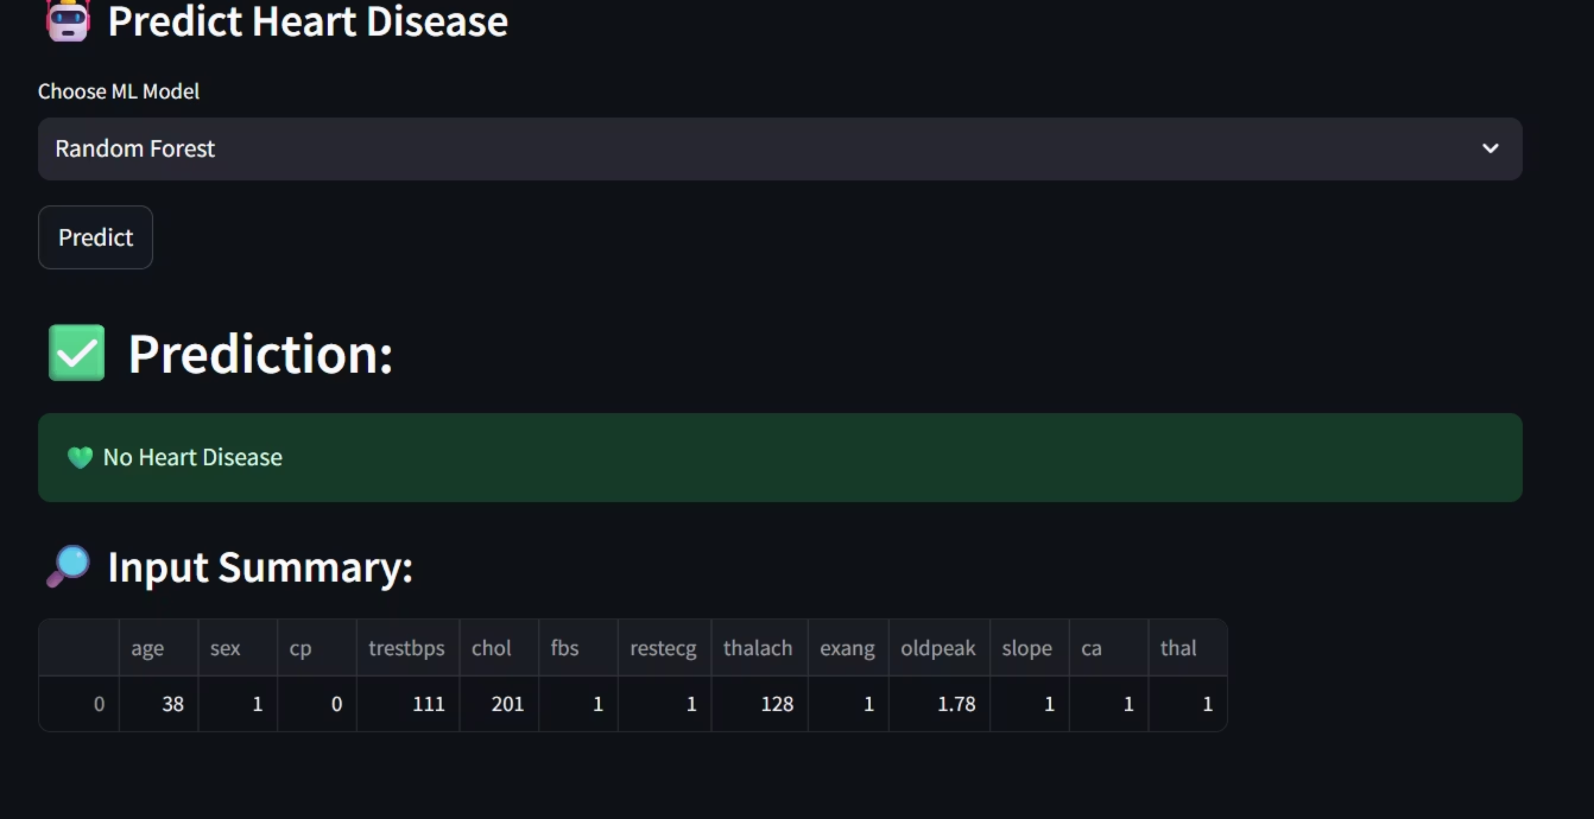

Slide 13
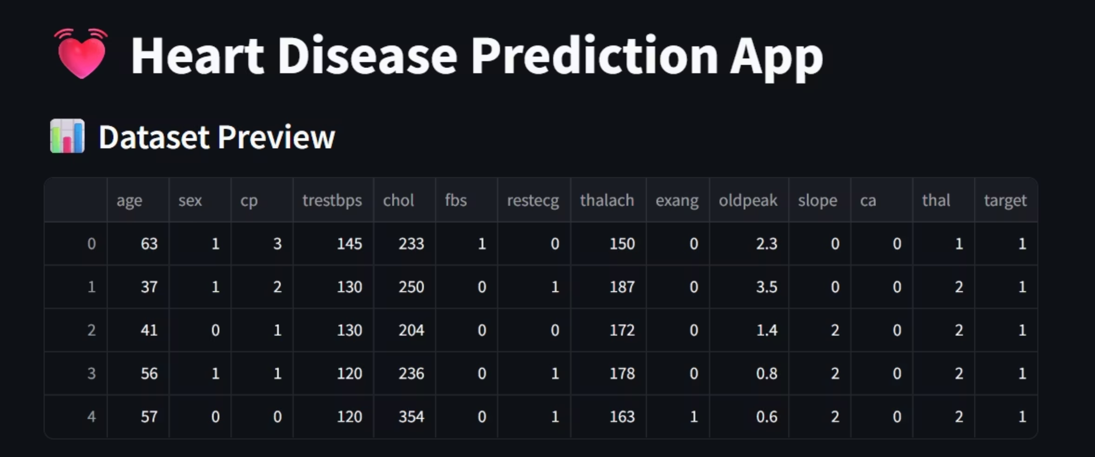

Slide 14
Results, Challenges & Future Work
Model Performance
Conclusion & Future Work
Logistic Regression: 86% Accuracy
Our project successfully demonstrated the potential of ML for heart disease prediction.
Random Forest: 91% Accuracy
K-Nearest Neighbors (KNN): 84% Accuracy
Develop a mobile application version.
Challenges Faced
Incorporate larger, more diverse datasets.
Explore advanced ML models like XGBoost and Neural Networks.
Imbalanced Dataset Handling
Model Selection & Hyperparameter Tuning
Q&A
Streamlit Deployment Complexities
Please feel free to ask any questions.
Click on this to see our project on Github !!

Slide 15

Thank you

